Slide 1

Update on GCMB Residency Training Permit online application submission
Georgia Composite Medical Board

Slide 2

About the Board
Mission Statement:
The mission of the Georgia Composite Medical Board is to protect the health of Georgians through the proper licensing of physicians and certain members of the healing arts and through the objective enforcement of the Medical Practice Act.

Slide 3
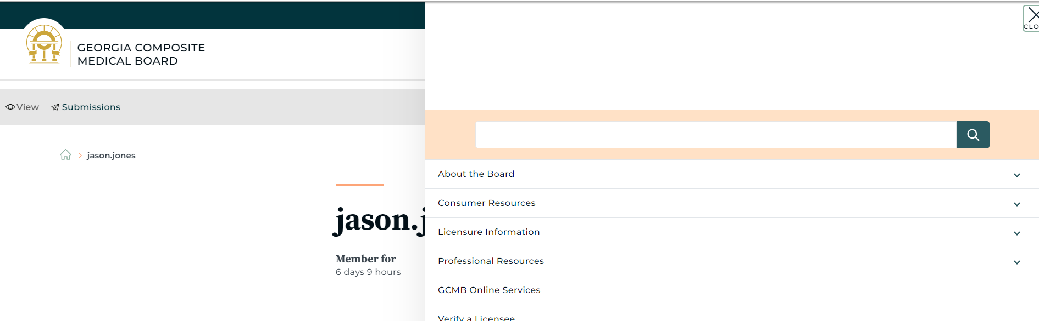
Online Portal
Go To: https://medicalboard.georgia.gov
Licensure Information
The GCMB website is currently being updated with the link to the
online portal and updated supporting documents

Slide 4
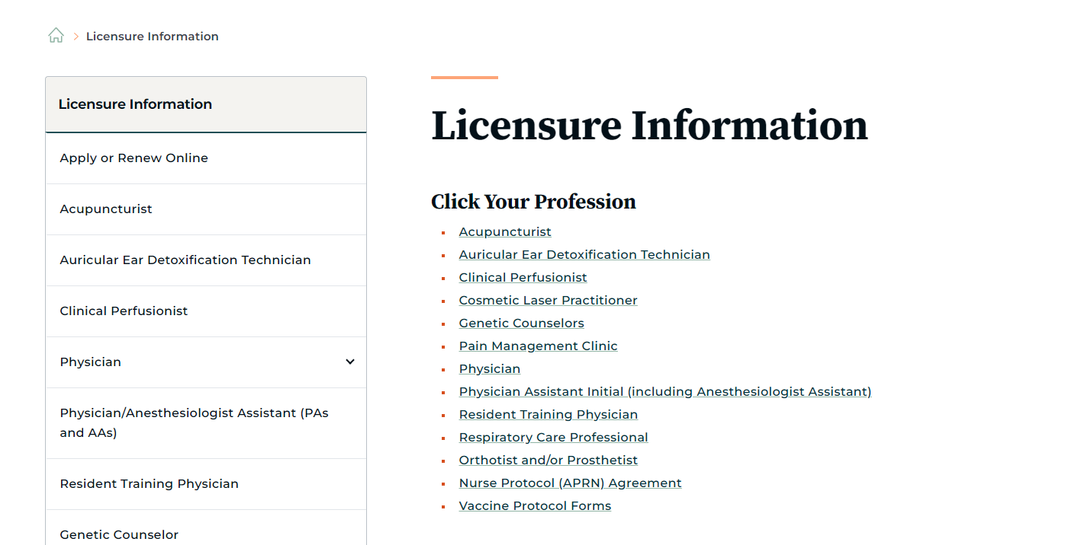
Licensure Information
Click on Apply or Renew Online

Slide 5
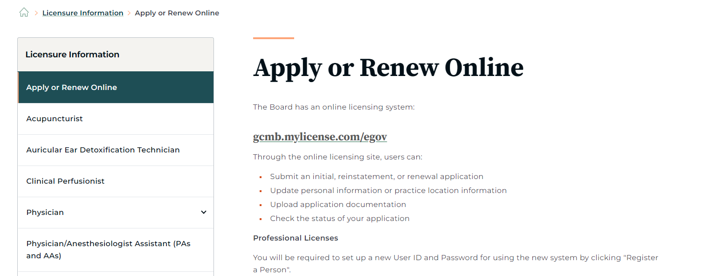
Apply or Renew Online
Click on https://gcmb.mylicense.com/egov

Slide 6
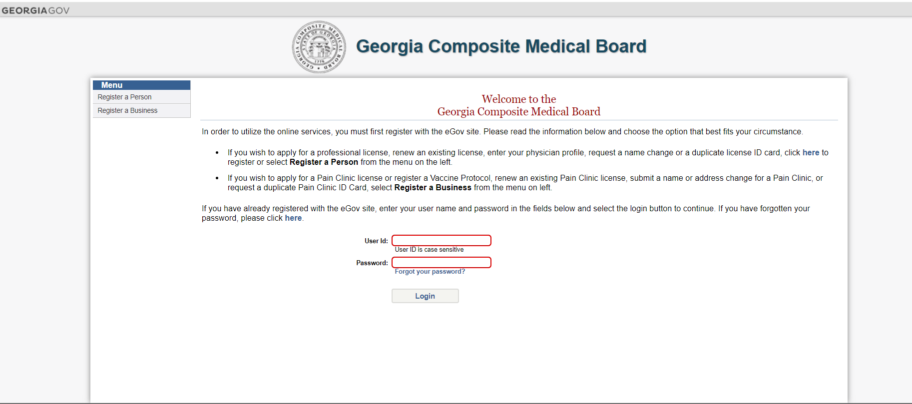
Click on Register a Person
If you are renewing your license or permit you can put in your user ID
and password and login
If you are new to the system use register a person

Slide 7
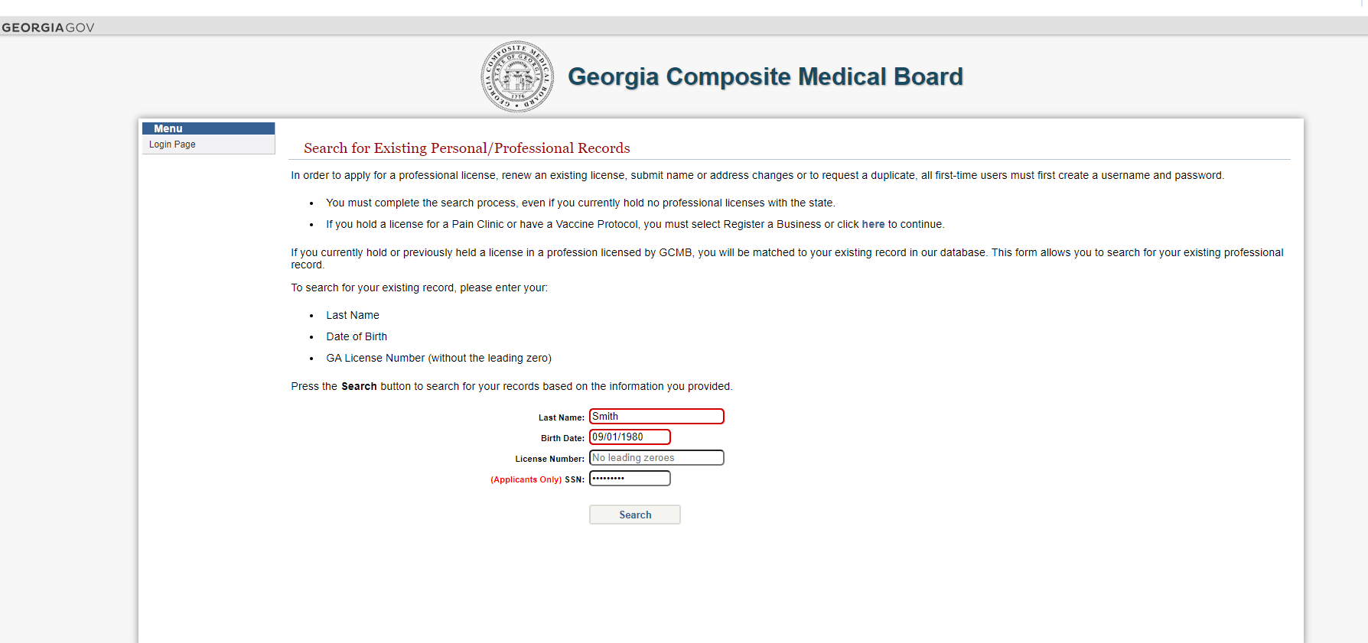
Fill in the blanks, click search

Slide 8
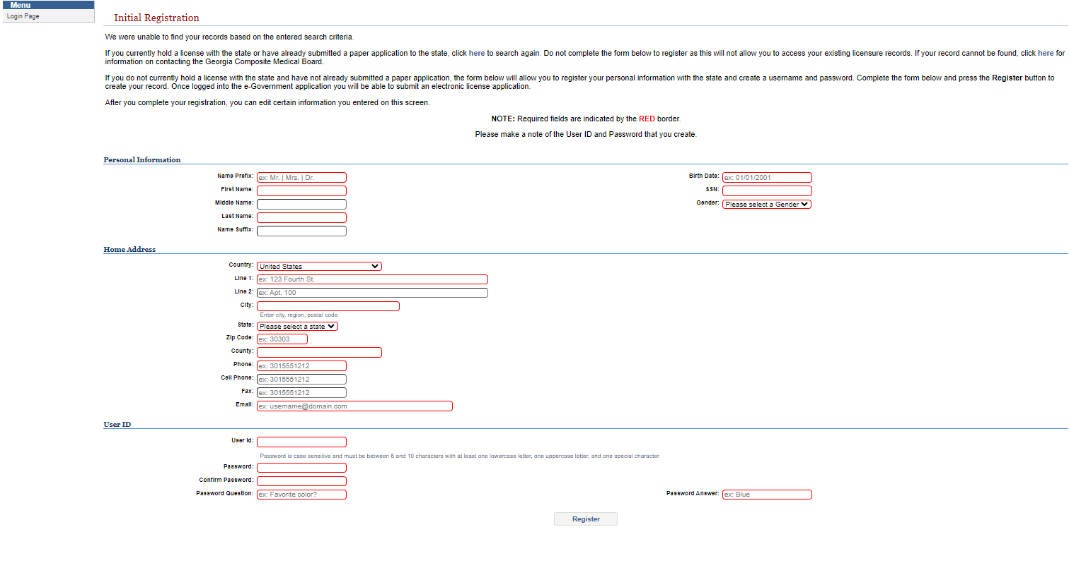
Initial Registration page
All items in red are mandatory; once these are filled in click Register
Please assure a valid email address is used

Slide 9
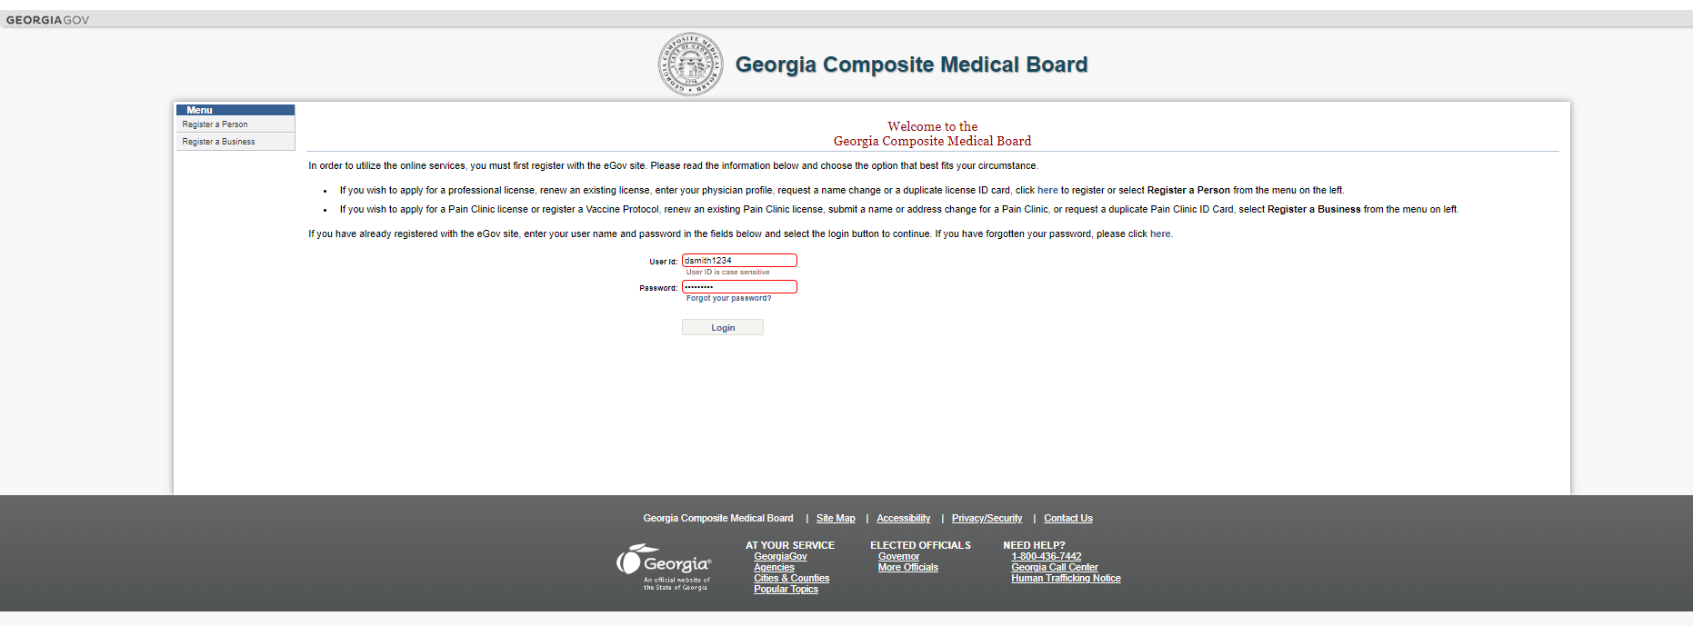
Put in your username and password
Type in your user ID and password you created during the initial registration
Click Login

Slide 10
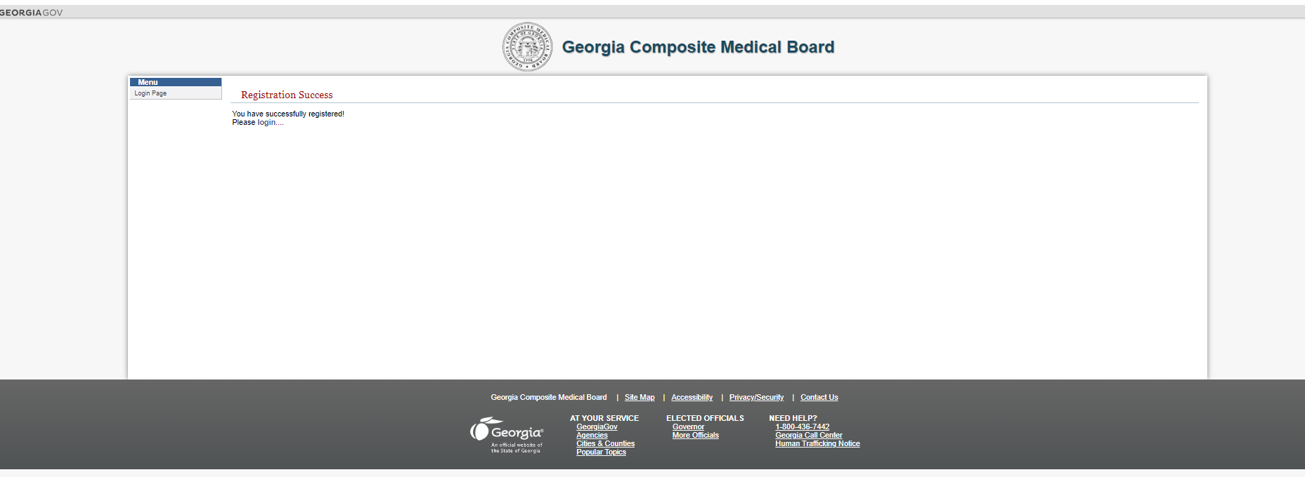
Click Login
Click Login to move to the next page

Slide 11
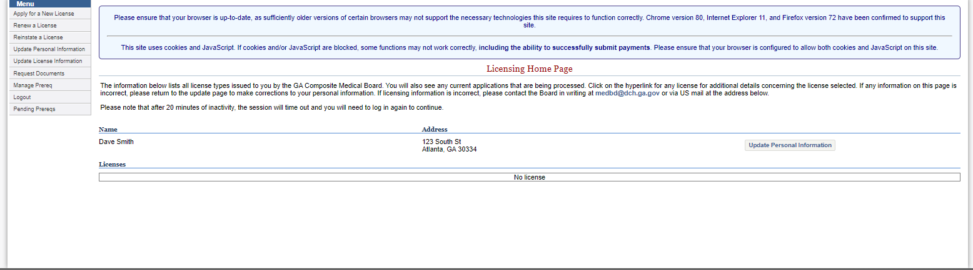
Start on left menu
Make sure all personal information is correct
Begin by clicking ‘Apply for a New License’
You will then move to the next page

Slide 12
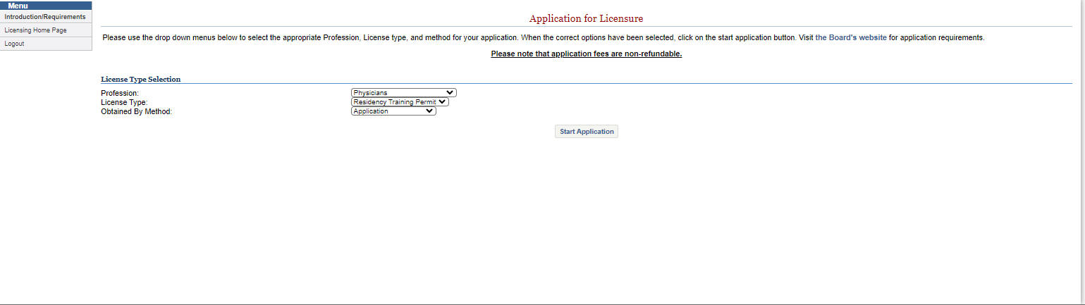
Fill in the 3 drop downs
Profession: Physicians
License Type: Residency Training Permit
Obtained by Method: Application

Slide 13
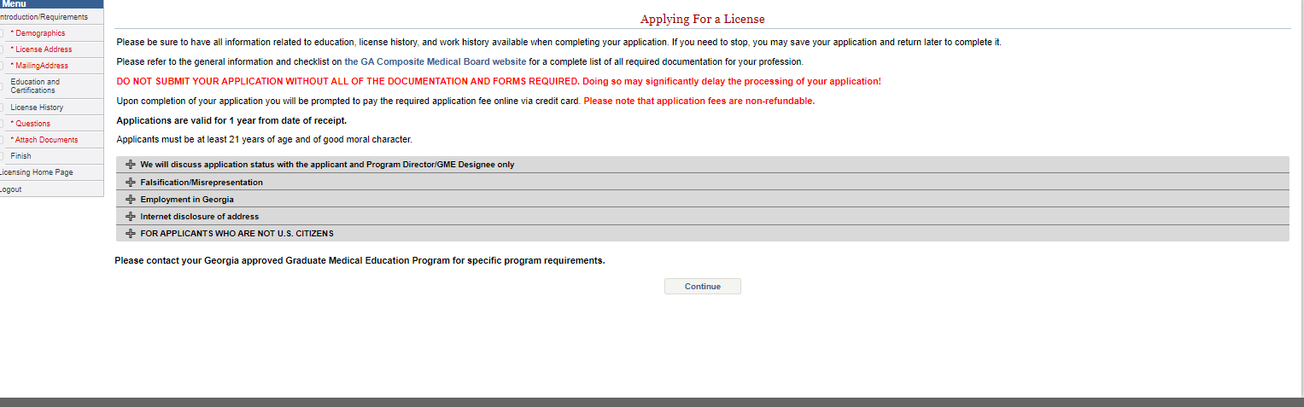
Applying For a License
Read and understand the 5 dropdowns
Hit continue

Slide 14
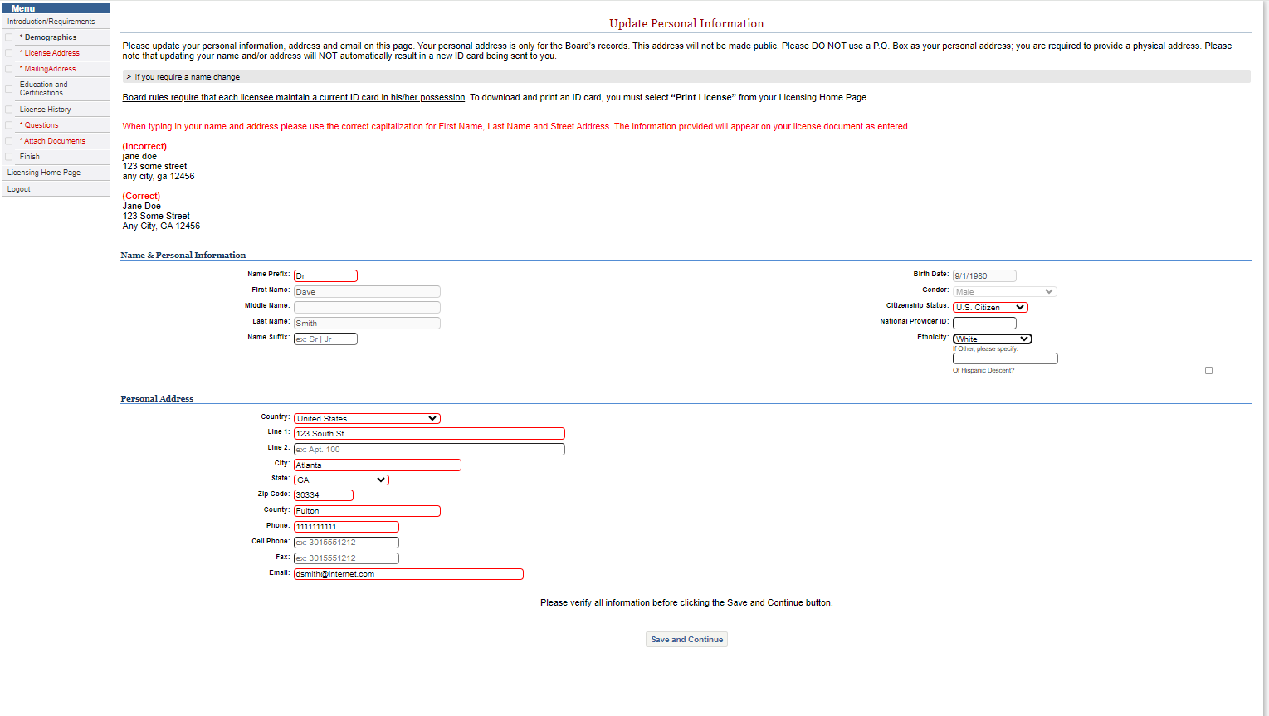
Update Personal Information
Be sure to follow the directions in red

Slide 15
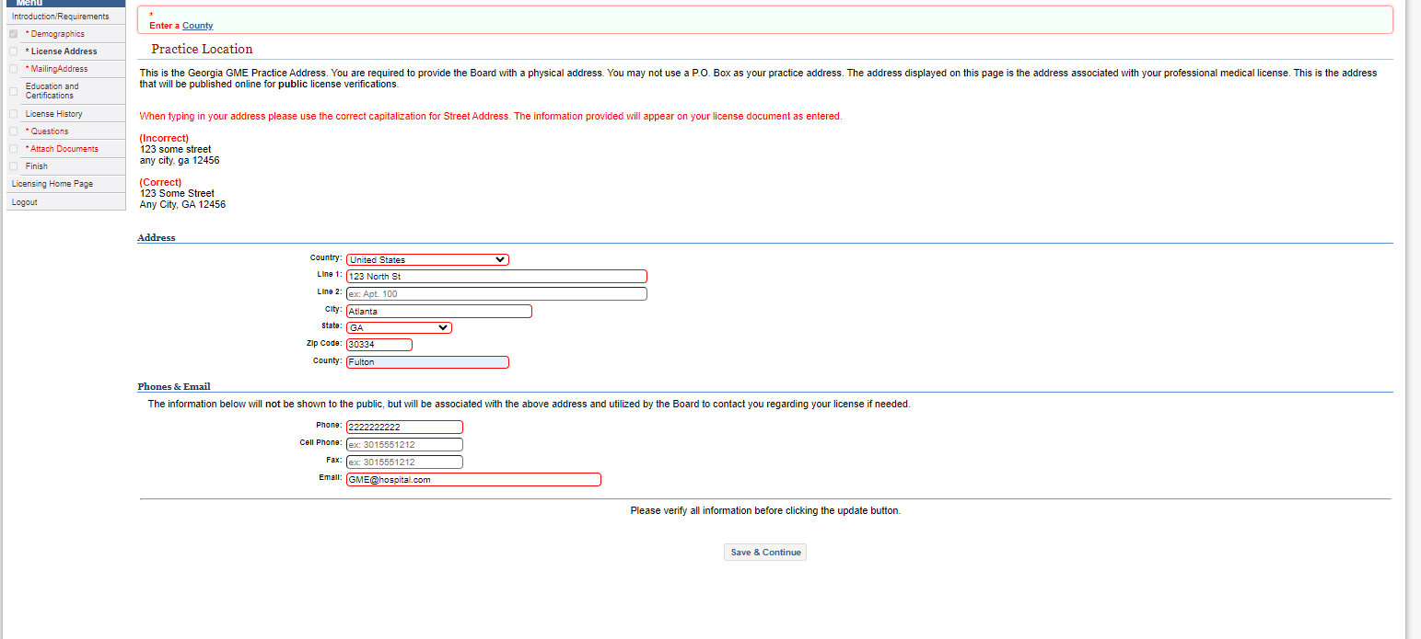
Practice Location
This is your GME, Program or Practice Address
  Confirm this with your program manager
The red areas are mandatory
Click Save and Continue

Slide 16
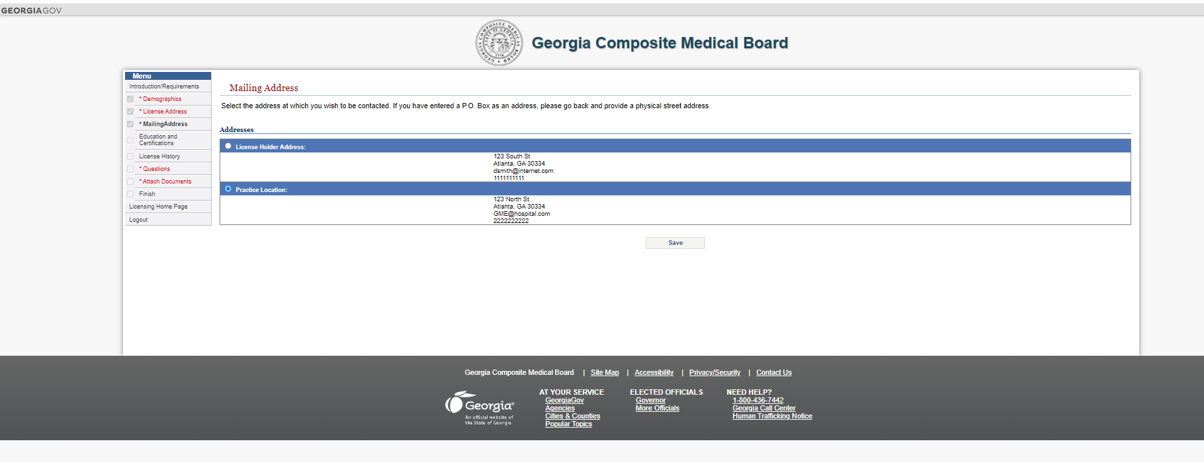
Mailing Address
For this purpose, click on the Practice Location

Slide 17
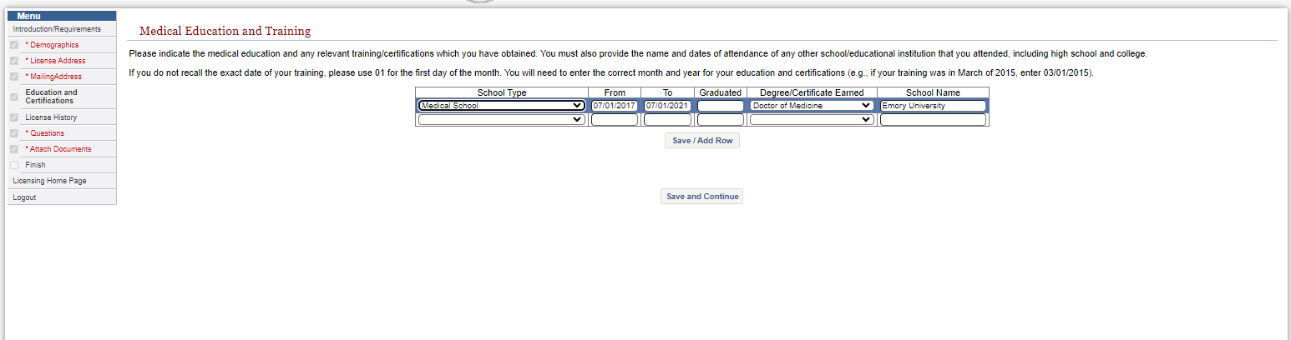
Medical Education and Training
School Type: , Medical School, Residency GME Program, etc.
From/To Dates – use this format 00/00/0000
Graduated Date: use this format 00/00/0000
  If no graduation date, then leave blank
School/program Name: Emory University, Augusta University, etc.
Save and Continue

Slide 18
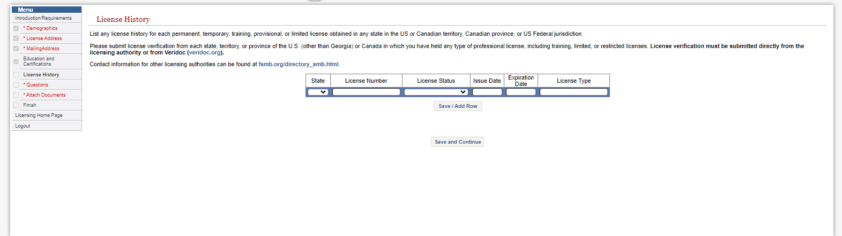
Professional License History
If you have or have held any professional medical licenses add them here
For certification of this information, the information must be submitted
directly from the licensing authority or veridoc.org

Slide 19
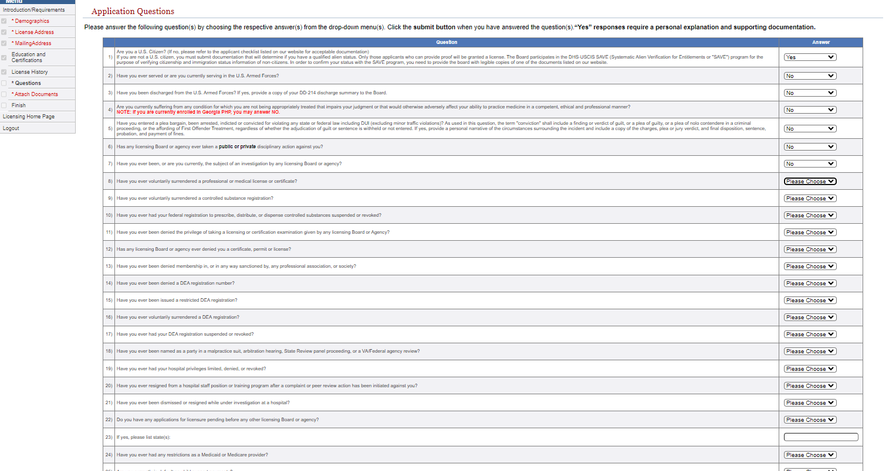
Application Questions

Slide 20
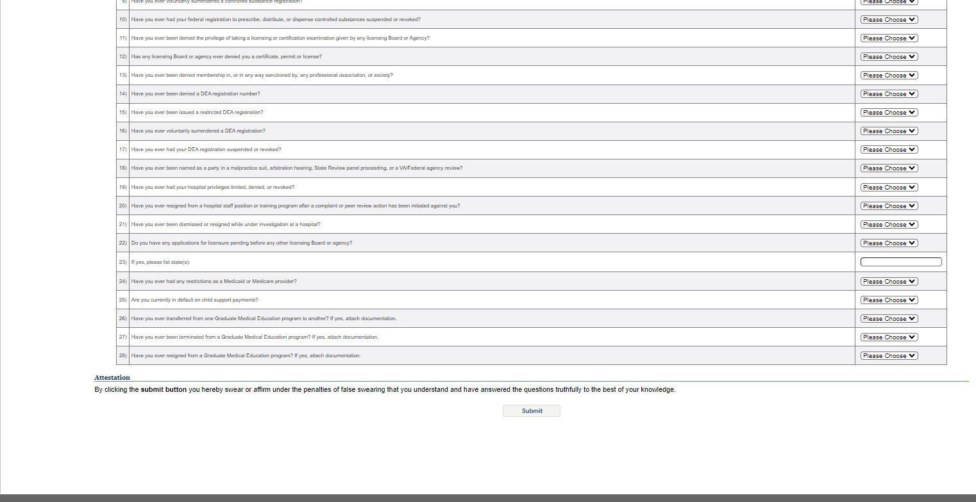
Application Questions Cont…
ALL questions MUST be answered to continue
Attest by hitting Submit

Slide 21
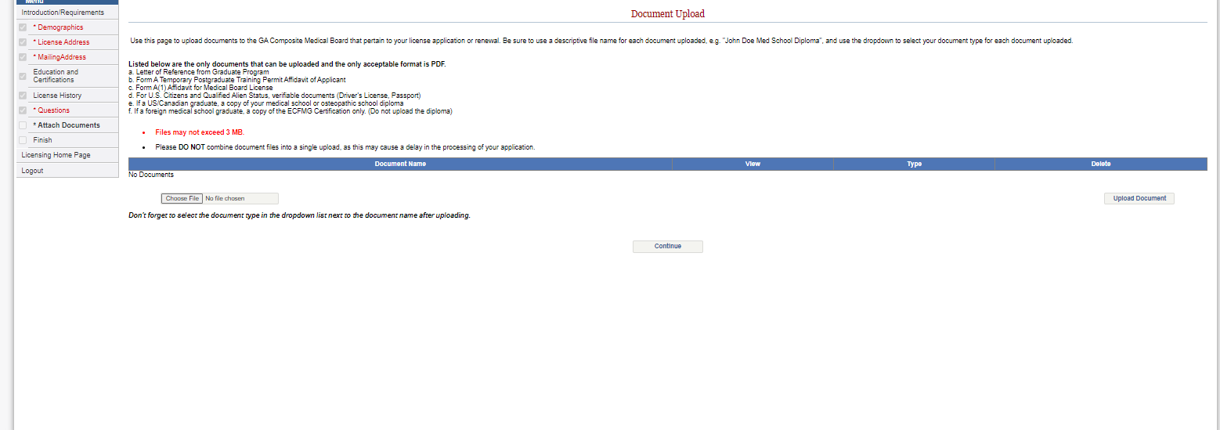
Document Upload
Assure all requested documents are uploaded (see below)
Be descriptive in your filename
“Listed below are the only documents that can be uploaded, and the only acceptable format is PDF.
a. Letter of Reference from Graduate Program
b. Form A Temporary Postgraduate Training Permit Affidavit of Applicant
c. Form A(1) Affidavit for Medical Board License
d. For U.S. Citizens and Qualified Alien Status, verifiable documents (Driver’s License, Passport)
e. If a US/Canadian graduate, a copy of your medical school or osteopathic school diploma
f. If a foreign medical school graduate, a copy of the ECFMG Certification only. (Do not upload the diploma)”

Slide 22
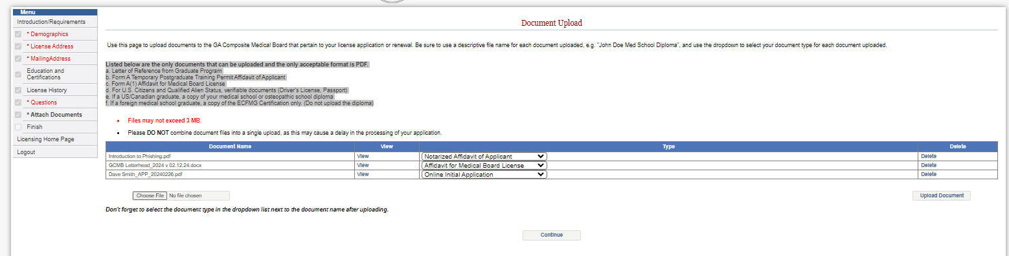
Document Upload Cont….
Once all required documents have been uploaded hit continue

Slide 23
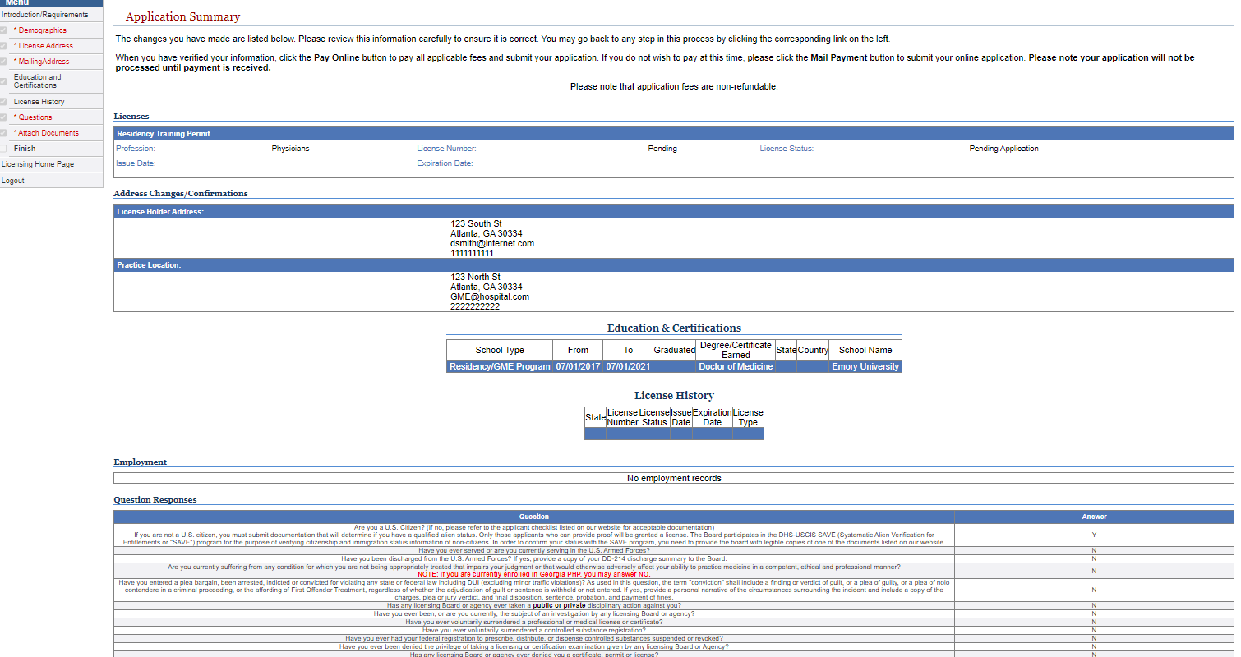
Application Summary
Check all information and make sure it is correct

Slide 24
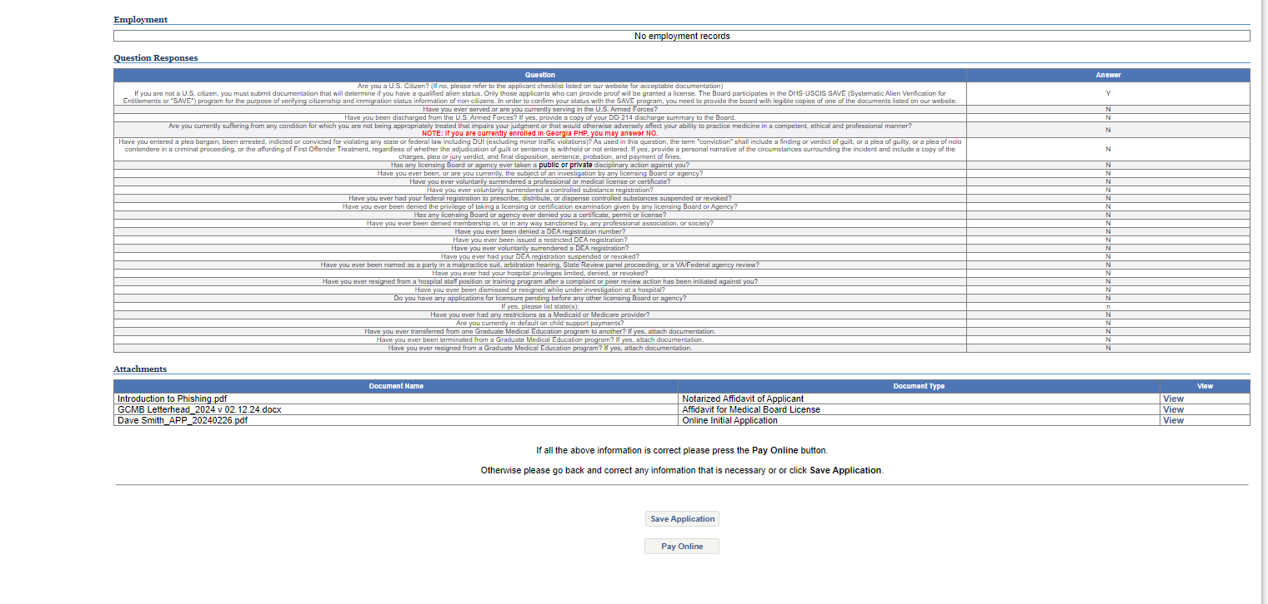
Application Summary Cont…..
Check all information and make sure it is correct
If all info is correct, click Pay Online
*** the “pay later” option is available only for those applicants
whose program is paying for their application***

Slide 25
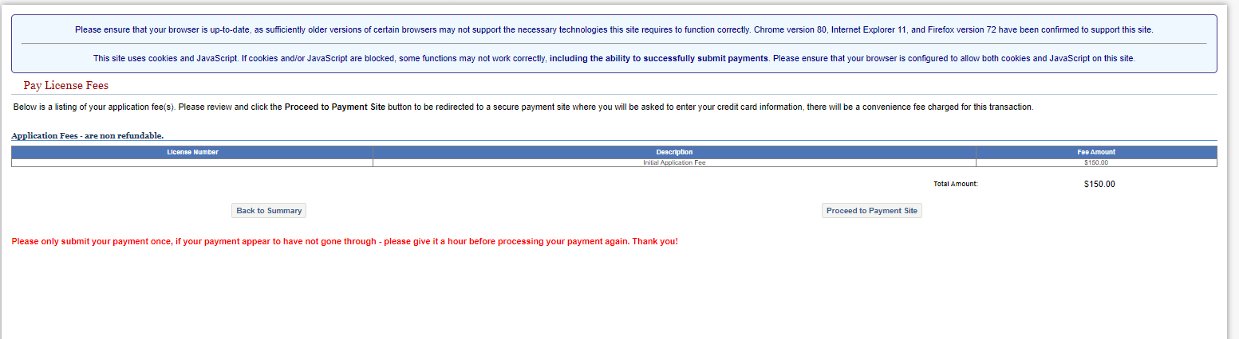
Pay License Fees
Make sure the appropriate fee is calculated
If so, click Proceed to Payment Site
Once there follow the instructions for payment
If you used the “pay later” option, your application will be submitted and
your program is responsible for payment; if the fee is not paid your
application will not be approved

Slide 26
NO PAPER
NO PAPER APPLICATIONS*
NO PAPER CHECKS*
ALL ELECTRONIC SUBMISSIONS*
* Unless prior approval from the Executive Director or Licensing Manager

Slide 27
Contact Information
Georgia Composite Medical Board
2 Martin Luther King Jr. Drive SE
East Tower, 11th Floor
Atlanta, GA 30334
Jason S. Jones
Executive Director
jason.jones@dch.ga.gov
404-709-1855 (call or text)
David Harris
Licensing Manager
david.harris@dch.ga.gov
Residency.Training@dch.ga.gov
Kimberly Emm
Deputy Executive Director/Legal Officer
Kimberly.Lemieux@dch.ga.gov
O: 404-656-3913

